Slide 1
electronRx Cardio Challenge
Henry Butlin

Slide 2
The task
Signal processing & feature extraction from 10 raw PPG datasets.
Cleaning
Missing data
…
Compare to expected results & modify strategy if necessary
Discriminate SR & AF
Visualisation
Thinking process rather than full code.

Slide 3
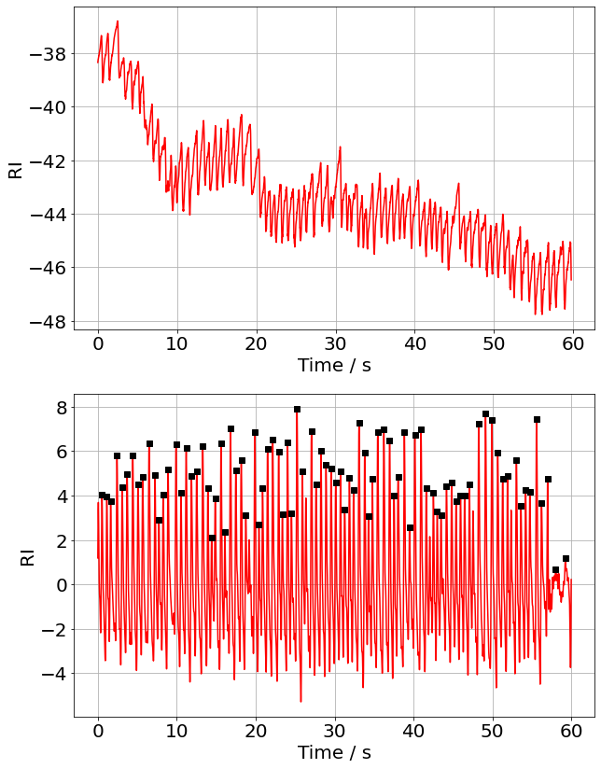
Signal Processing First approach: FT (C-code)
RAW PPG
bandpass filter & SciPy peak finding *
(see .c file on GitHub)
Noisy, drifting baseline
Improved! But:
Results not a great match to expected
FT can’t handle missing data (see later slide)
* peaks, _ = find_peaks(df.r, height = 0.1, distance = 35)

Slide 4
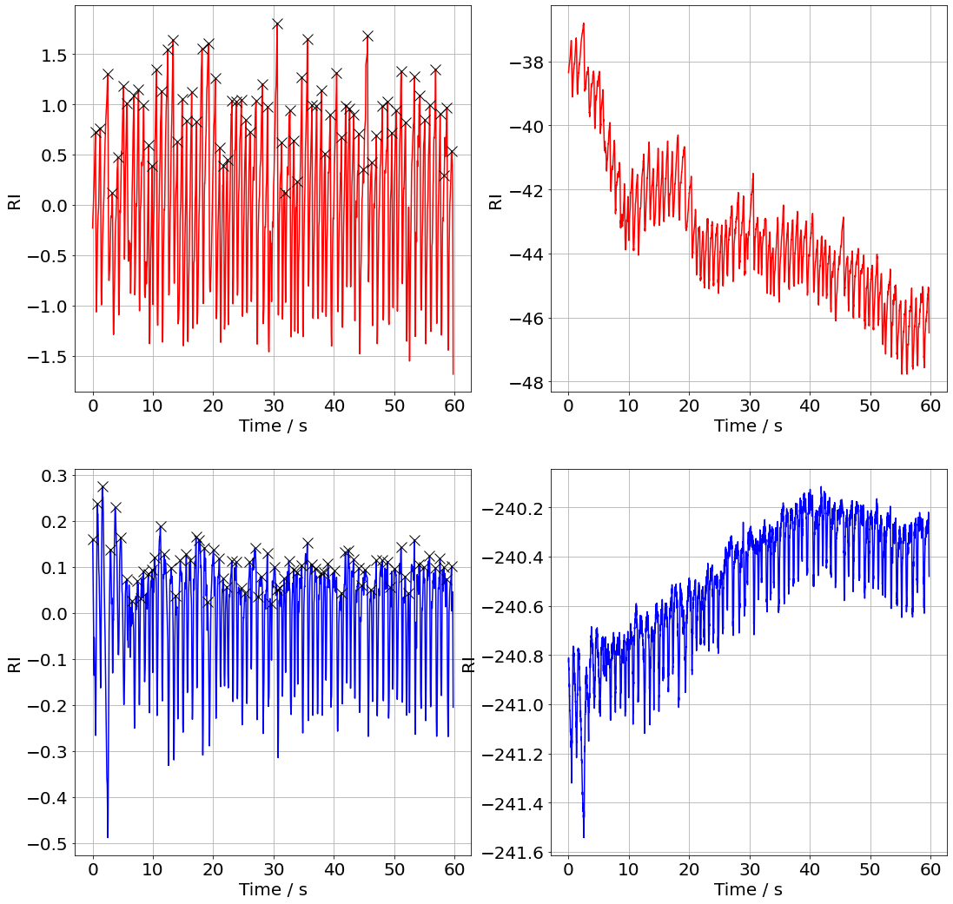
Second approach: Python toolkit
RAW PPG
(Rescaled)
SciPy Savitzky-Golay noise filter, polynomial baseline correction & peak find
RAW PPG
(Rescaled)
Better!
Can handle gaps in data
Results closer to expected

Slide 5
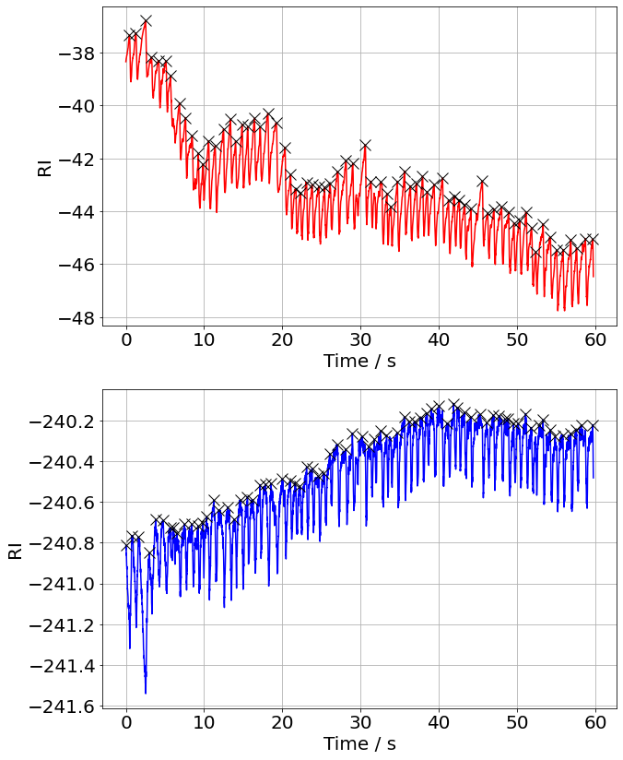
Peak find on raw data?
RAW PPG
To see if the signal preprocessing was having a positive effect, I coded my own peak detection program that didn't need filtered data.
This worked by finding the positions of the local maxima within incremented windows of data, and yielded visually correct results.
RAW PPG

Slide 6
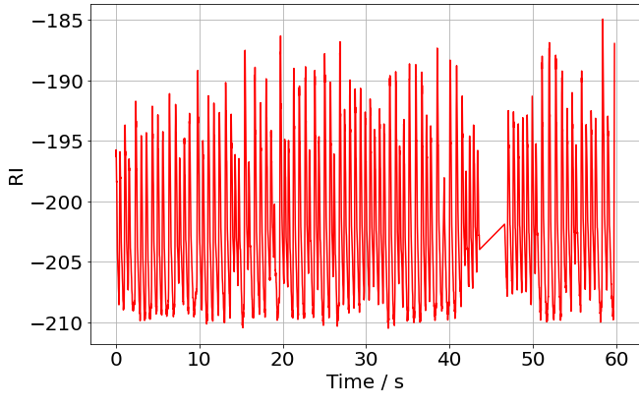
Missing Data
Some of the raw PPG files were missing rows of data.
As a quick and crude workaround, obtained heart rate was multiplied by the fraction: n_{expected}/n_{actual}
With more time, small gaps could be filled by maximum entropy interpolation, and larger ones by deep learning models such as recurrent neural networks.
GAP!
n_{actual}
n_{expected}

Slide 7
Results
Expected
Processed
Raw
My code yields the rMSSD, SDNN, and pNN50, but for simplicity only HR is displayed here
In five cases the filtered results are better than the unfiltered ones – my filtering hasn’t changed information content, but has visually improved the data
I investigated the significant outlier in filtered …
File | HR (exp) | HR (SG, P) | HR (raw)
2022-06-07 09-15-58 | 76.0 | 76.6 | 77.6
2022-06-07 11-04-55 | 56.4 | 56.3 | 55.3
2022-06-07 11-22-35 | 89.3 | 92.0 | 85.6
2022-06-14 09-42-01 | 70.6 | 83.1 | 70.1
2022-06-07 09-51-55 | 88.3 | 87.4 | 88.4
2022-06-14 09-31-19 | 54.3 | 87.0 | 63.7
2022-06-14 12-55-43 | 57.1 | 65.3 | 52.2
2022-06-14 11-07-24 | 74.2 | 79.4 | 73.3
2022-06-14 11-55-02 | 66.4 | 66.1 | 67.1
2022-06-07 10-03-36 | 65.4 | 65.1 | 63.1

Slide 8
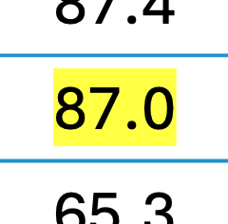
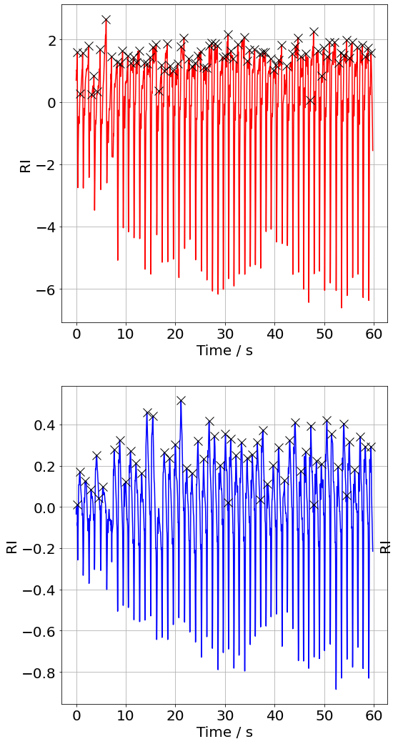
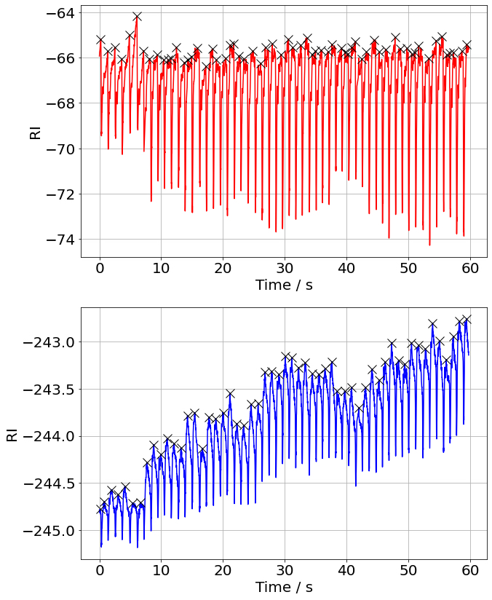
Non-matching Metrics
Filtered PPG
RAW PPG
The highlighted anomalous value was the only significantly different value
The source of this error appears to stem from counting secondary peaks
(May be clinically significant?)
Could be fixed by a more sophisticated filtering technique or peak detection algorithm (e.g. AMPD*)
Filtered PPG
RAW PPG
*Article link

Slide 9
Atrial Fibrillation vs Sinus Rhythm
A study conducted in 2020 found that a deep learning approach was successful in detecting AF from raw PPG data.*
Here, the rMSSD, SDNN, or pNN50 metrics could be used as crude differentiators between AF and SR.
As AF is characterised by irregular heartbeats, it seems plausible that a larger range of heartbeat intervals would imply AF.
A brief visual inspection of the raw PPG waveforms might also be an effective initial screening method.
*Article link

Slide 10
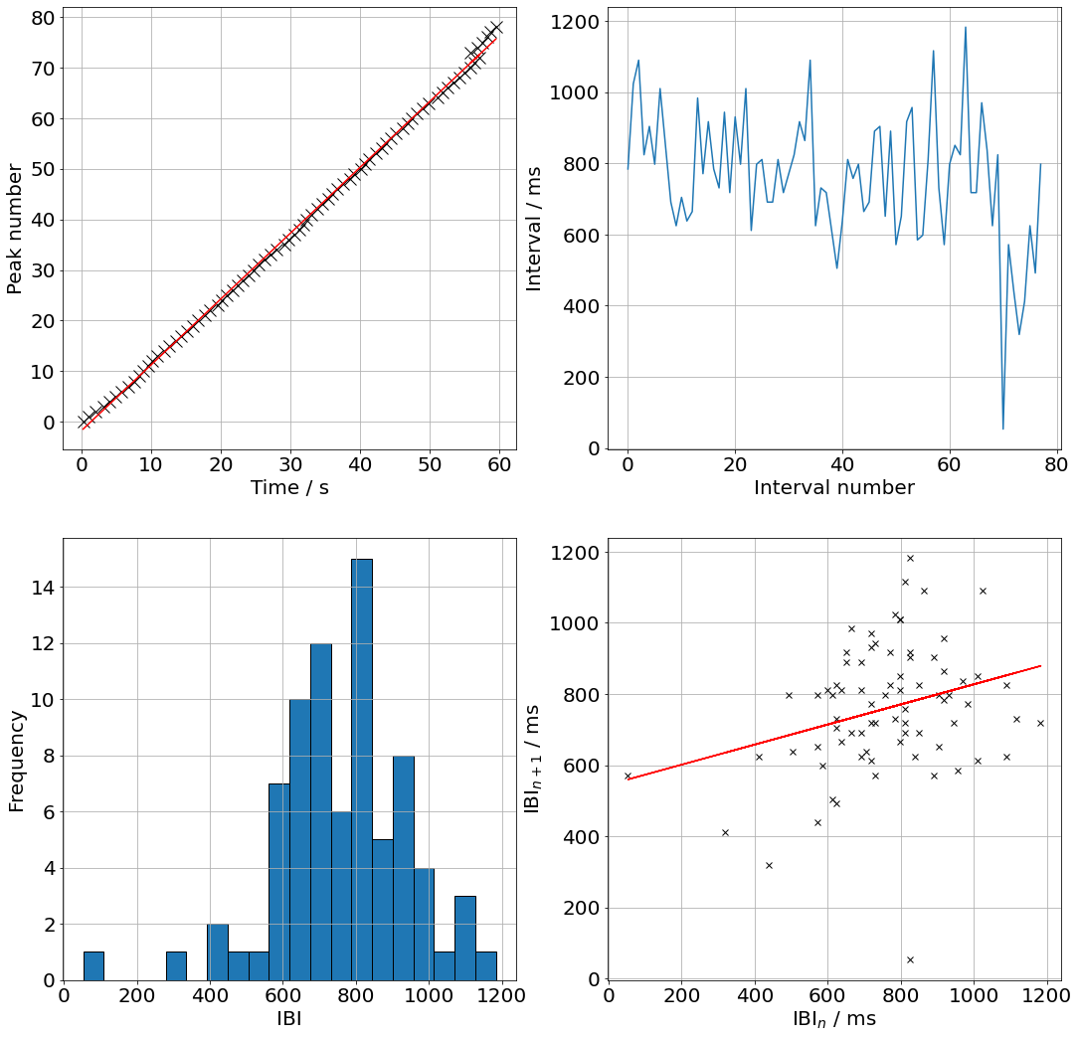
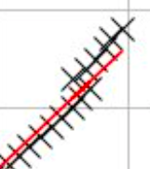
Visualisation
Examples of ways to visualise and verify these results.
In some cases one or more of these plots showed something was going wrong (e.g. peak vs time was non-linear), which would be useful for future debugging.

